Slide 1
PHP in depth 10
3870

Slide 2
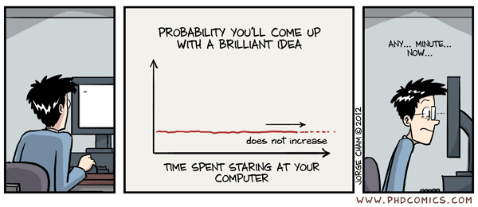

Slide 3
Migration Tip
Make sure that if your table name is "locations", that your model is Location
Also make sure that you type the following if autoloading does not work (after adding a new class)
composer dump-autoload

Slide 4
Exercise 1
Use the "Pics" feature of ggc-talk.
The user is not able to edit an entry in the favorites tab.
Add an edit button in the favorites tab.
Which fields should not be editable?

Slide 5
Exercise 2
Implement the upvote and downvote feature.
How would you order the favorites by upvotes?

Slide 6
Exercise 3
How would we add the ability for our users to comment on a picture in the favorites tab?

Slide 7
Eloquent Collections
<?php
// app/routes.php
Route::get('/', function()
{
$collection = Album::all();
});

Slide 8
first(), last()
<?php
// retrieves first and last from the collection
// app/routes.php
Route::get('/', function()
{
$collection = Album::all();
var_dump($collection->first());
//var_dump($collection->last());
});

Slide 9
shift(), pop()
<?php
// shift and pop removes the element
// app/routes.php
Route::get('/', function()
{
$collection = Album::all();
var_dump(count($collection));
var_dump($collection->shift());
//var_dump($collection->shift());
var_dump(count($collection));
});

Slide 10
iterate over collection with each()
<?php
// app/routes.php
Route::get('/', function()
{
$collection = Album::all();
$collection->each(function($album)
{
var_dump($album->title);
});
});

Slide 11
create a new collection with map()
<?php
// app/routes.php
Route::get('/', function()
{
$collection = Album::all();
$new = $collection->map(function($album)
{
return 'An ode to a fair panda: '.$album->title;
});
var_dump($new);
});

Slide 12
create a new subset with filter()
<?php
// app/routes.php
Route::get('/', function()
{
$collection = Album::all();
$new = $collection->filter(function($album)
{
if ($album->artist == 'Something Corporate') {
return true;
}
});
var_dump($new);
});

Slide 13
sorting is possible
<?php
// app/routes.php
Route::get('/', function()
{
$collection = Album::all();
$collection->sort(function($a, $b)
{
$a = $a->year;
$b = $b->year;
if ($a === $b) {
return 0;
}
return ($a > $b) ? 1 : -1;
});
$collection->each(function($album)
{
var_dump($album->year);
});
});

Slide 14
reverse(), merge()
$reverse = $collection->reverse();
$a = Album::where('artist', '=', 'Something Corporate')->get();
$b = Album::where('artist', '=', 'Matt Nathanson')->get();
$result = $a->merge($b);

Slide 15
slice() just like in php
<?php
// app/routes.php
Route::get('/', function()
{
$collection = Album::all();
$sliced = $collection->slice(2, 4);
$sliced->each(function($album)
{
echo $album->title.'<br />';
});
});

Slide 16
isEmpty(), toArray(), count()
var_dump($a->isEmpty());
var_dump( $collection->toArray() );
var_dump( $collection->count() );

Slide 17
Exercise
Reimplement the imgur assignment in Laravel

